Slide 1

ACT Australian Education Union
Designing safer healthier work for ACT Principals:
What you can do!
Dr Peta Miller
30 May 2025

Slide 2

I acknowledge the Traditional Custodians of the Canberra region of the Ngunawal and Ngambri people.
Canberra is derived from a Ngunawal word meaning meeting place.
I pay my respects to Elders past, present and emerging and celebrate the diversity of all Aboriginal peoples and their ongoing cultures and connections to the lands and waters of ACT and beyond.
I also acknowledge and pay my respects to our Aboriginal and Torres Strait Islander colleagues joining us today.
Always was; and always will be Aboriginal lands.
Notes:
50
Room layout groups tables
I live and work on lands that are shared by the Ngunawal and Ngarigo peoples and a meeting place for the Yuin.

Slide 3
Today’s session
Sustained WHS improvements requires a systems approach
Your stress, fatigue and burnout matters
Common psychosocial hazards and risks for ACT Principals and that typically may apply to your staff
How you can use work design to move towards better psychosocial risk management
  Conceptual models
  Identifying hazards and risks and using systems thinking
Practical work redesign strategies you can consider
ACT wide and cluster intervention suggestions
Q&A
Notes:
More than peer counselling arrangements individual interventions problem system level
Focus on work design/ Being consulted, doing RCA /Rights based working week and
Effects of stress make choices where they can ed direction tells them principles as officers and workers at the same time.

Slide 4
It is unacceptable that a risk of harm to you (or your staff) is seen as just an inevitable part of delivering high quality education in the ACT.
Your employer’s obligation to provide high quality education never overrides their legal duty to protect your health and safety!
School principals’ [as workers] needs are sometimes forgotten, [safety] of their work environment does not receive much attention from their superiors.
Persson et al., (2025).
Notes:
Persson, R., Leo, U., Arvidsson, I. et al. School principals’ proposals for preventive actions to improve mental health. Arch Public Health 83, 19 (2025). https://doi.org/10.1186/s13690-024-01481-4 https://archpublichealth.biomedcentral.com/articles/10.1186/s13690-024-01481-4#citeas

Slide 5

Systems thinking
ALL those in control of the design and management of work should
Understand education delivery occurs in a complex system with multiple interconnected and interacting components (tasks, processes, working environment, information and data, machines and people) and must reflect the ‘work as real’ not ‘imagined or hope for’
Use root cause analysis
  Look for obvious and less obvious causes of poor WHS
  Understand who are the obvious and hidden work designers- make them accountable
  Implement system level changes
Move towards designing in ‘organisational resilience’– rather than viewing workers as the ‘problem’ and relying on lower order controls
Source: Adobestock
Notes:
A useful tool to go beyond a simplistic traditional WHS risk assessment is to use systems thinking to look more closely for the underlying design and management causes for an incident
Systems thinking is an approach used in work design that identifies and considers the dynamic relationships between key parts of the work system that are often below the surface and how these can be designed to eliminate or reduce risks.
Understand its delivery occurs in a complex system with multiple interconnected and interacting components (people, tasks, processes, machines and data) and must reflect the ‘work as real’ not ‘imagined or hope for’
Use root cause analysis – to look for obvious and less obvious causes of poor WHS
Move to ‘organisational resilience’ – rather than view workers or Principals as the ‘problem’ to systematically better work designs and management approaches to create safer healthier work everyone
Help us find the obvious and the hidden ‘causes” (why and how) of psychosocial risks
Change the focus changes focus from the worker as the ‘problem’ and lower order controls poor design and management of the whole work system creates WHS risk–
This allows design solutions that prevent harm to any person doing the job

Slide 6
Risks arise from many levels and sources
Other Agencies and Community
Minister & Ed Directorate
Budgets, Policies, Leadership and Culture, Governance and Management Systems , curriculum requirements etc.
School
Funding, infrastructure design and layout, EL, Board, structure, culture, educational approach etc.
Principal
Role, situational demands, knowledge, skills, experience, beliefs, leadership and working style, spare capacity, mental and physical health etc.
Staff
Number, experience, teaching style, spare capacity, mental and physical health etc.
Student Community
Numbers, needs, expectations, behaviours etc.
Appropriate action is required by ALL ‘those with control over or design work to SFARP manage the WHS risks they create
Adapted from Carayon and Gurses 2008
Notes:
WHS risks are derived from sources at many levels within the education ecosystem

Slide 7

Your stress, fatigue and burnout should not be viewed as a ‘lack of personal resilience’
These are a natural human physiological, emotional, cognitive and behavioural responses to situations when the work demands exceed peoples’ capacity to cope
Everyone will break if stress is too high for too long
This Photo by Unknown Author is licensed under CC BY
Notes:
Everyone breaks it is NOT a matter of nurses ‘lack of personal resilience’ so red flags if your organisation is relying on stress management and wellness programs
The physiological, emotional, cognitive and behavioural response to situations when the demands exceed the person’s self-perceived capacity to cope
Organisations can and MUST do everything they can practically do to improve the design of the work and how it is managed so their nurses won’t be harmed by their work.

Slide 8

Why your stress, fatigue and burnout matter
In addition to impacts on you and your family
your health and safety is inextricably linked to your ability to be an effective school leader
Notes:
Not only for you and your families but so, you will also have the spare mental, physical and emotional capacity to design, lead and manager healthier and safer schools

Slide 9
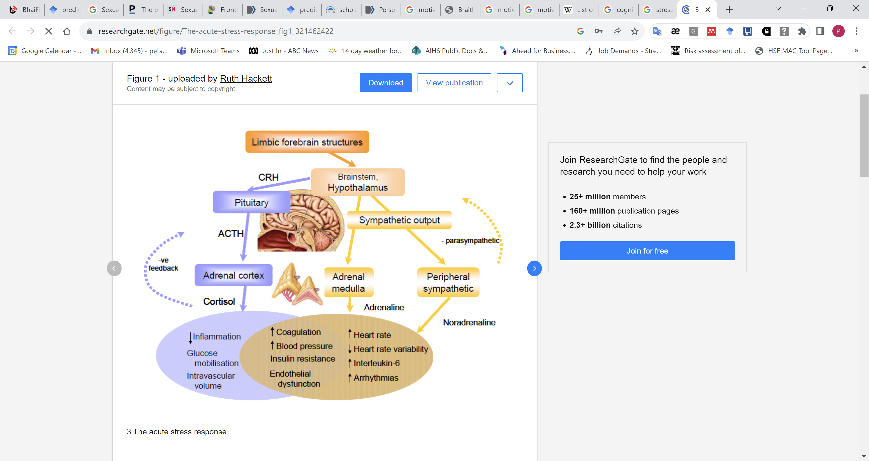
Known physiological responses with acute and chronic health impacts
Increased
Sleep disturbance
Psychological (anxiety, depression, suicidal ideation)
Gastrointestinal (nausea, vomiting etc.)
Traumatic injuries and MSDs
Chronic diseases (CVD, diabetes, cancers, urological etc. )
Reproductive health impacts, and
Obesity and poor health and self care behaviours etc.
(Silva et al 2020 and others)
Notes:
As teachers you are aware of the varied physiological changes from acute and chronic stress.
Rates of chronic diseases, PTSD, depression, anxiety, suicidal ideation, MSDs injury risk and Traumatic injuries (from errors). But lets not also forget the less obvious issues such as chronic disease and reproductive health impacts particular as we age

Slide 10

Long working hours
> 55 hours per week
39.40% mortalities
25.90% of morbidities
(WHO/ILO, 2023; Pega, et al., 2023)
Health impact depends on:
Total working hours and their predictability
Presence of moderating work factors (like practical and emotional support, resources, and success)
Opportunity for genuine rest breaks and task variety when at work
Opportunities for sleep and recovery between shifts
Ability to take leave when needed
Worker’s health status and personal circumstances
This Photo by Unknown Author is licensed under CC BY
Notes:
Aside on long working hours which is one of the known issues for the education sector

Slide 11

Cognitive and physical performance impairment
50% slower reaction times and accuracy
  > Attention tunneling = < situational awareness
  < Concentration and memory
  < Organised thinking > Reliance on ‘heuristics’ - unconscious mental shortcuts
  > Bias in decision making
  > Deference to power and pressures
>Task shedding (adaptive or nonadaptive)
> Increased reliance on training (adaptive or nonadaptive)
<Muscle strength and endurance
  =
  > Errors - slips, lapses, execution errors, knowledge mistakes
  > Workarounds and rule violations
  van Dijk et al 2019; Jackson and Frame 2018; Moser et al 2013; Drew et al 2012
Notes:
We tend to make more errors as we rush or forget to do things, we understandably narrow our focus on just what's in front of us so we may miss important other information and we need to revert to instinctive ways of thinking and behaving… that’s okay if we are well trained and it’s the right thing to do like dealing with a medical emergency but it also makes us very prone to bias. Finally, if we are stressed we are more likely to just go with the group or the most powerful person’s views even if we think they are wrong that matters if we want an organisation that innovatively deals with problems
All of this means there are increased risks of us making errors
NOTES
Slips and lapses – made inadvertently by experienced operators during routine tasks;
Mistakes – decisions subsequently found to be wrong, though the maker believed them to be correct at the time; and.
Violations – deliberate deviations from rules for safe operation of equipment.

Slide 12
Emotional and behavioural reactions
Increased
Fight, flight and freeze response (less ‘face’)
Emotional reactivity
Dysfunctional behaviours (conflict, bullying and harassment)
Anxiety, depression, burnout and intention to quit*
Poorer performance (avoiding tasks, errors, taking safety shortcuts, procedure violations)
Presenteeism & absenteeism
Communication effectiveness
Tolerance and empathy
Trust in self and others
Willingness to spend ‘discretionary effort’ (help-out, mentor etc.)
Engagement and cooperation
Job satisfaction
Decreased
Stress impairs performance and education services
and
poor performance is highly stressful
  *Dickie, Kidson and March 2025, van Dijk et al. 2019, Jackson and Frame 2018, Moser et al. 2013, Drew et al 2012
Notes:
We tend to be more sensitive and may flare at things we would otherwise let slide
When we are stressed the natural human reaction to conserve our efforts and protect ourselves
Disengagement (presenteeism & absenteeism) and poor performance (avoiding tasks, errors, taking safety shortcuts, procedure violations)

Slide 13

Stress models
Knowledge about evidence-based stress models and controls gives you information to powerfully advocate for safer and healthier work design
These models are understood and supported by WHS regulators!

Slide 14
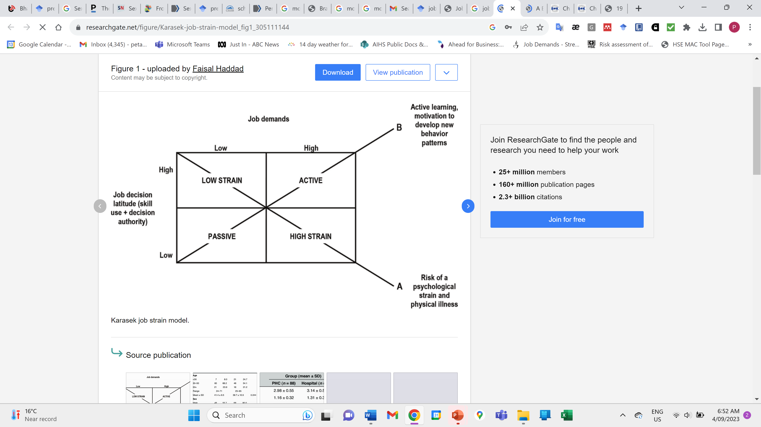
Job Demand Control Model
Considers
Job demands (workload) - physical, psychological, social, or organisational aspects of the job, required to sustain work effort or skills
Job decision latitude
Desired job design
Creates more active (satisfying) jobs
Avoids high strain and passive (boring) jobs
Individuals can be a workplace hazard
Karasek & Theorell,1990, Johnson 1986; Kristensen 1995 and others
Notes:
Job Demand-Control-Support model (Karasek & Theorell,1990), Effort-Reward Imbalance model (Siegrist, 1998), which posits that effort invested by a worker is part of a social contract reciprocated by appropriate rewards (e.g. money, esteem and social control) they gain. Other psychosocial hazards listed, such as interpersonal conflict, (poorly managed) change and organisational (in)justice, have been included due to the strong evidence base regarding their association with job strain.
Later expanded to include ‘social support’ as a third dimension

Slide 15
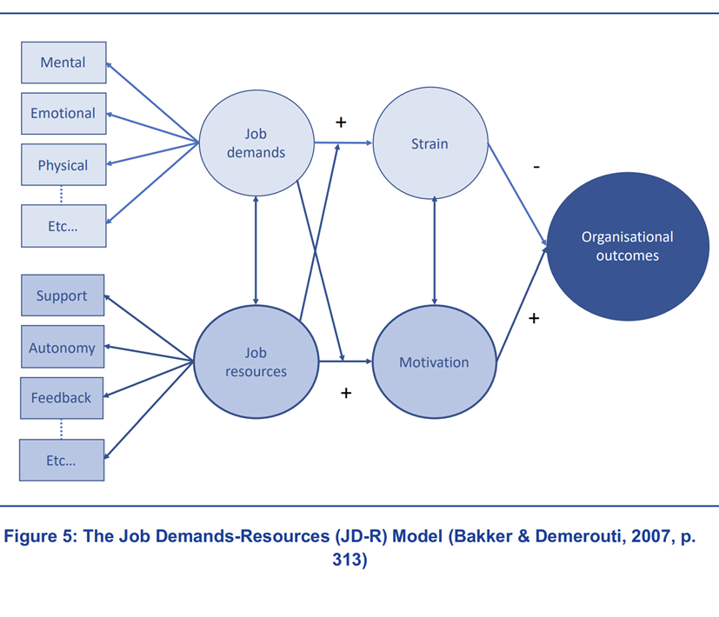
Job Demand-Resources Model
Expanded Job Demand Model to include
Job resources (support) -the physical, psychological, social, or organisational resources/aspects required to do the job,
Impact on motivation and organisational outcomes
Imbalance leads to negative individual and organisational outcomes
Individuals can be a workplace hazard
Resources can buffer negative effects of excessive demands. Impact greater when demands are high.
Notes:
The job demands-resources model (JD-R model) is an occupational stress model that suggests strain is a response to imbalance between demands on the individual and the resources he or she has to deal with those demands.
Job demands: physical, psychological, social, or organizational aspects of the job, that require sustained physical and/or psychological effort or skills. Therefore, they are associated with certain physiological and/or psychological costs. Examples are work pressure and emotional demands.
Job resources: physical, psychological, social, or organizational aspects of the job that are either: functional in achieving work goals; reduce job demands and the associated physiological and psychological cost; stimulate personal growth, learning, and development. Examples are career opportunities, supervisor coaching, role clarity, and autonomy.
Note the difference between workplace resources vs. personal resources:
Success is a powerful ‘stress moderator’
Identify and remove critical ‘performance impediments’**

Slide 16
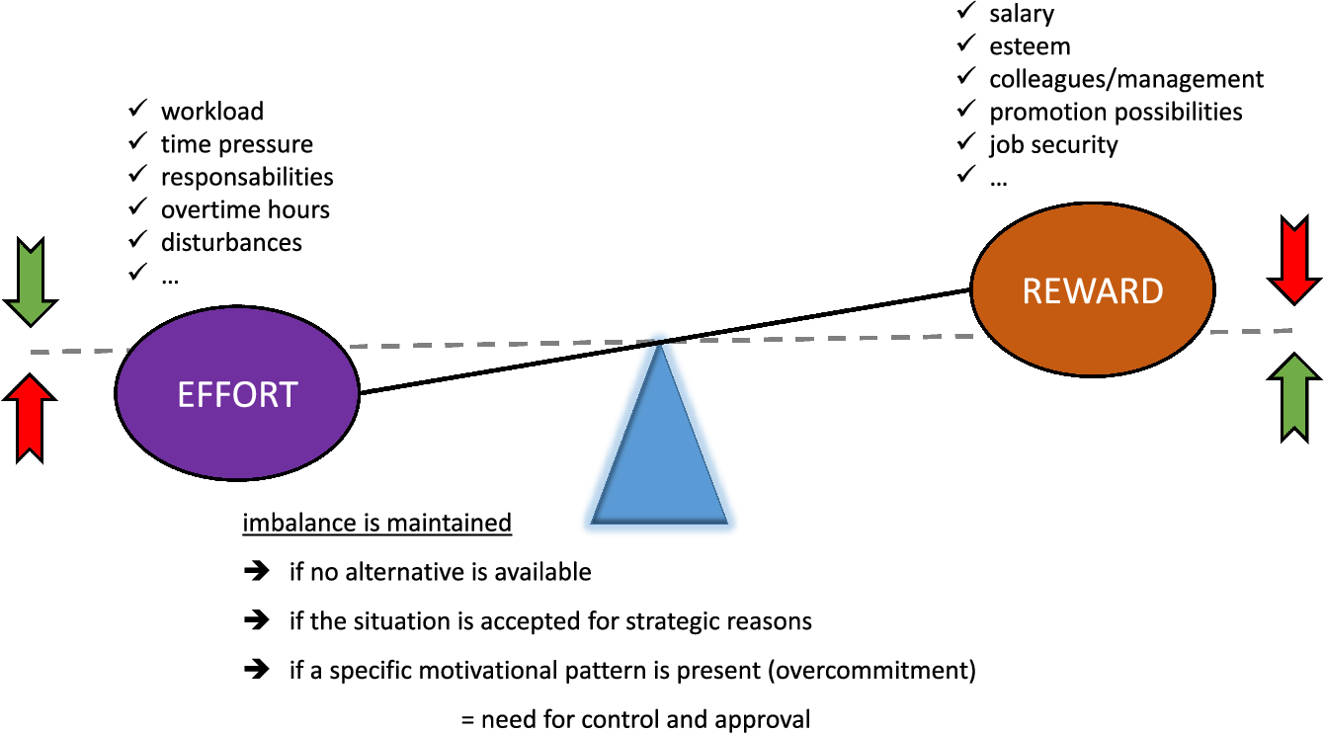
Effort Reward Imbalance Model
Reward fairness judged against parity with peers and society’s expectations*
Success is a powerful reward and ‘stress moderator’
Siegrist, 1996
Notes:
Effort reward balance model recognised them need for perceived and actual rewards for high effort
Notes:
The effort-reward imbalance (ERI) model is a theoretical model of a psychosocial work environment with adverse effects on health and well-being that focuses on a mismatch between high efforts spent and low rewards received at work. In the model, effort means the demands and obligations the employee is faced with, and reward the money, esteem, and career opportunities (or job security) the employee expects in return, not only from the employer but also from society at large (Siegrist, 1996)

Slide 17
Psychosocial hazards and risks
Aspects of the job and situations at work that may cause stress and fatigue which in turn can lead to psychological and physical harm
Likelihood of harm from exposure depends on the
Duration of exposure (how long)
Frequency of exposure (how often)
Severity of exposure (how high), and
How different types of hazards interact or combine in your school
The higher and longer exposures are present the higher risk of psychological and physical harm
Notes:
There are two broad types of exposure to psychosocial hazards and risks - both lead to harm:
• Cumulative exposures: these occur gradually and build over time which reduces a person’s capacity to cope and increases stress
• One-off highly stressful events: this includes experiencing, or being exposed to, a traumatic event such as witnessing a serious injury or fatality or experiencing threats of harm, serious injury, or sexual violence.

Slide 18
Psychosocial and physical hazards and risks
Deeper understanding of the sources of the interacting hazards and risk creates opportunities for better design and management
Stem from poor design and management of
Ed. Directorate
Educational facility organisational structure, governance, work arrangements, organisational and sub-cultures
Job and task - psychosocial and physical demands
  Some tasks within a job are inherently hazardous*
School processes and systems– how work is organised and managed
School’s working environment
  Design layout and working conditions of classrooms, playgrounds and administration areas
  Design and maintenance of equipment, IT & IM systems
  Provision of adequate educational supplies
Social factors - relationships, interactions and behaviours, leadership styles and team cultures, and
And
People – our innate human characteristics, values, skills & attributes and non-work-related individual factors
Notes:
Psychosocial hazards at work are aspects of work and situations that may cause a stress response which in turn can lead to psychological or physical harm. They can stem from the:
• The way the tasks or jobs are designed, organised, managed and supervised
• Tasks or jobs where there are inherent psychosocial hazards and risks
• The equipment, working environment or requirements to undertake duties in physically hazardous environments, and
• Social factors at work, workplace relationships and social interactions.

Slide 19

Common psychosocial hazards

Slide 20

Poor organisational leadership, governance and culture and climate
Lack of genuine WHS commitment and leadership
Unrealistic financial operating models and IR conditions
  Inadequate budgets and policy to support realistic staff student ratios
  Inability to recruit and retain teachers with the right skills mix and experiences etc.
Poorly designed and integrated governance and administrative policies and procedures
Frequent, poorly communicated, perceived unnecessary organisational change
Poor (perceived and actual) ED or school organisational justice (application of rules, performance management processes)
Zhou et al., 2024
Notes:
Government unrealistic financial operating models
Inadequate budgets and policy to support realistic staff student ratios, prompt appropriate recruitment and incentives to retain staff
Difficulties recruiting teachers with the right skills mix and experiences
Teaching loads making it difficult to delegate tasks without causing them stress
Management issues: frequent, poorly communicated, perceived unnecessary organisational change*
Poor (perceived and actual) departmental and organisational justice
Application of rules*
Performance management processes*
Employment IR arrangements and history – job security
If you and your staff WHS viewed as tokenistic or a serious commitment
Emm Prof Andrew Hopkins illustrates what executives need to do to avoid deaths, debt, scandals, and reputational damage – how executives they can choose to “do the right thing”. Executives should, amongst other activities:
Develop a Reporting Culture,
Foster a Just Culture,
Improve Feedback Mechanisms,
Tie Executive Bonuses to Safety Metrics,
Adopt Active Hazard Identification, and
Monitor Precursor Events.

Slide 21

High general job demands
Long working hours- quantity of work (1st)
  Large increasing span of responsibilities
  Frequent interruptions and disruptions (increases mental load especially when doing complex and time critical tasks)
  Time pressure and deadlines
Lack of time to teach and support learning (2nd)
Staff shortages (7th)
Lack role clarity
  Views over competing educational priorities
  Around Principals legal duties/ WHS control (PCBU, Officer, worker)
Dickie, Kidson and March 2025, Zhou et al., 2024; ACT Worksafe

Slide 22
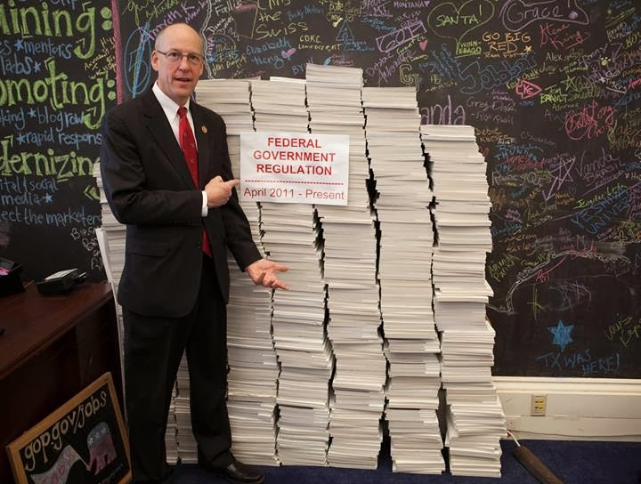
Administrative clutter
The unhelpful accumulation of education and safety procedures, documents, roles and activities that are performed in the name of efficiency and safety but with dubious value.
Safety clutter can create and perpetuate harmful beliefs about safety
Rae, Provan, Weber and Dekker 2018
Assess if these help efficiency, effectiveness and safety. If not negotiate for their elimination or improved design!
This Photo by Unknown Author is licensed under CC BY

Slide 23

Cognitive demands
Information processing volume and complexity (perceiving, attending, remembering, problem-solving and decision-making)
Your mental or cognitive load increases with
Task complexity
Need for vigilance (not making errors)
Unfamiliar tasks
Lack of information
Others lateness / lack of help
Physically challenging conditions (distractions, low light, noise, poor workplace physical ergonomics)
Emotionally demanding situations (threats, need to provide support to distressed students and staff)
and
When you are tired, stressed or unwell
This Photo by Unknown Author is licensed under CC BY-SA-NC

Slide 24
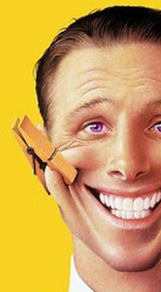
Emotional and cognitive demands
As an educator your professional values demand consistent displays of calmness, rationality, empathy and caring (even when others are unreasonable, ill-informed or abusive)
How often is there a dissonance between your feelings and values and your required behaviours?
Student issues and behaviours (3rd)
Staff and student mental health (5th )
Staff shortages and issues: lack of availability, skills, mental and physical health needs (6th)
Impact of errors
  Justifiable worry over actual or perceived backlash from students, families, community or department over your decisions or in response to critical incidents
Dickie, Kidson and March 2025; Grandey, 2000; Hochschild, 2012; Jed, 1998; Morris & Feldman, 1996
Notes:
As an educator your personal and professional values demand consistent displays of calmness, rationality, empathy and caring (even when others are unreasonable, ill-informed or abusive)
Emotional labour is the effort, planning, and control needed to express organizationally desired emotions during interpersonal transactions. (Morris & Feldman, 1996)
The process of managing emotions such that they are suitable to organisational or professional display rules. (Grandey, 2000)
Consider the demands for nurses to :
display of empathy, caring and extent of emotional dissonance* (deep vs surface acting)
Dissonance between your values and required behaviours (Hochschild, 2012)
Actual or perceived impact of errors* (Jed, 1998)

Slide 25
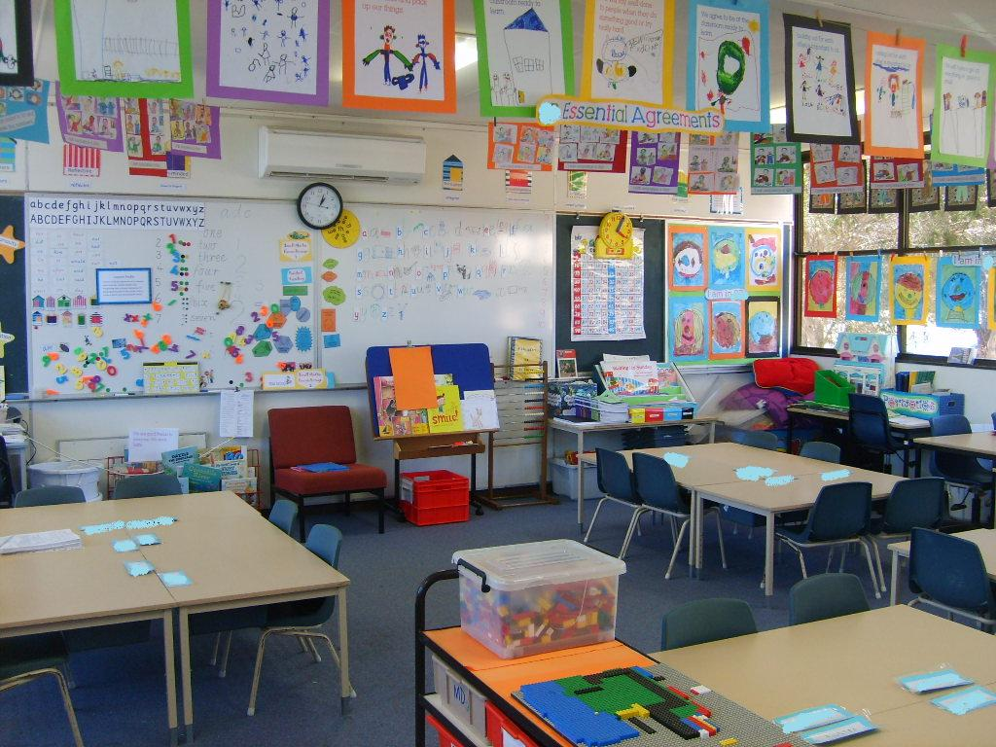
Physical demands
Uncomfortable office or workstation design
Physically isolated work (working alone after hours)
Hazardous manual handling (restraining children, handling books and teaching resources)
Extended periods of standing or walking
This Photo by Unknown Author is licensed under CC BY-SA-NC
Notes:
Physical work and task demands

Slide 26
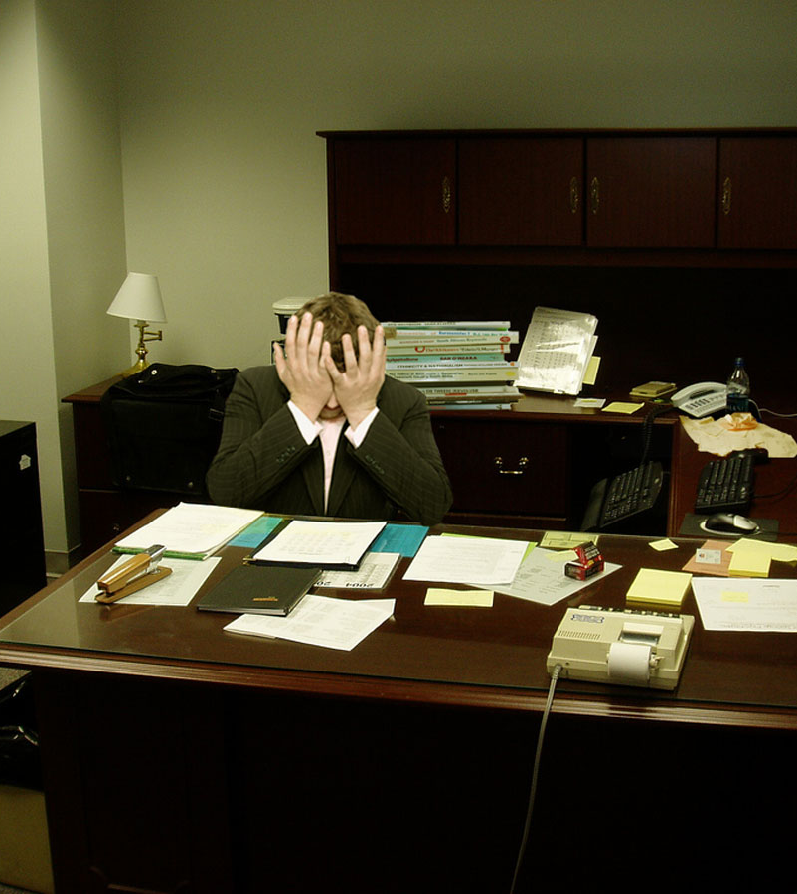
Low job control and task variety
Low control/decision latitude/autonomy (what, when & how to do tasks) with high responsibly
Goal conflict (staff safety vs student safety and time to provide care)*
Low task variety (poor mix of challenging and routine tasks)
Inadequate opportunities for mastery
  Use your skills
  Career advancement
Mausbach, von Känel, et al., 2008; Ma, Faber, & Dubé, 2007; Matthews et al., 2006; and others
Your level of responsibility should be matched with a commensurate ability for you to control the risks
This Photo by Unknown Author is licensed under CC BY-NC-ND
Notes:
Principals in theory have high job control/autonomy and task variety but…high responsibility without commensurate ability to control critical risks (e.g., financial, student profiles)* is highly stressful
Activities with ‘purpose that you value’, that allow a sense of mastery, reasonable control and variety and peer social acceptance are powerful stress moderators
Hill, P. L., Best, R. D., & Cardador, M. T. (2021). The Purpose and Work Stress model: Contextualizing the role of purpose on and following stressful work experiences. In P. D. Harms, P. L. Perrewé, & C.-H. (D.) Chang (Eds.), Examining and exploring the shifting nature of occupational stress and well-being (pp. 1–17). Emerald Publishing. https://doi.org/10.1108/S1479-355520210000019001
And see (Mausbach, et al., 2006) and physical health outcomes (Matthews, Owens, Edmundowicz, Lee, & Kuller, 2006; Mausbach, Patterson, et al., 2007). Mastery has also been associated with reduced risk for mortality (Penninx, et al., 1997). A greater sense of mastery might also buffer the impact that chronic stress can have on disease (Ma, Faber, & Dubé, 2007; Mausbach, Mills, et al., 2007; Mausbach, von Känel, et al., 2008).

Slide 27
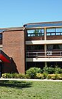
Poor practical support
Governance and IM systems
Are these a hazard or a help?
Directorate based governance systems
School based systems e.g.,
  Budgets and expenditure
  Infrastructure project
  Staff and workload management systems
  Student academic records
  WHSE and security risk management systems
Appropriate consultation and user trials done before new governance, technology or IMS introduced
Proactive reviews to ensure these are a help and not adding ‘administrative and safety clutter’
This Photo by Unknown Author is licensed under CC BY-SA
Notes:
These include:
Governance arrangements
Policies, procedures, procurement rules
Reporting
Systems for high-risk student interactions
These can be a hazard or a help. Poorly designed IMS a common source of frustration and stress and are often ignored.
Ensure appropriate consultation and trials before new technology, IT or and management systems are implemented

Slide 28

Poor instrumental support
Inadequate
School and facility design
Maintenance budget
Teaching and office supplies
Equipment design, access and maintenance
and
Information, training, supervision and instruction to use faculties and equipment safely and well
School facilities, equipment and tools must be’ fit for purpose’, ‘fit for your people’ (anthropometrics) and ‘fit for your needs i.e. when and where they are needed’

Slide 29

Poor informational support
Inadequate information, instructions and feedback from ED about
  current and expected government and local issues, priorities and
  governance and management requirements
Unclear performance standards and agreements (up-to-date, reflect ‘work as real’, fair, and fairly and consistently applied)*
Proactively consult, cooperate and coordinate with other relevant duty holders and entities and workers
Notes:
Insufficient practical support when it is needed
Success is a powerful ‘stress moderator’
Identify and remove critical ‘performance impediments’**

Slide 30

Workplace social support and behaviours
Level, type and frequency of unacceptable workplace behaviours (team conflict, incivility, aggression & bullying)
Poor coworker and peer support
A common default is a punitive investigation and blame the worker.
Yet poor behaviours often ‘response’ to exposure to risks at work.

Slide 31

Thankyous do NOT replace fair pay and workloads
Poor emotional support
Style and frequency of emotional support from supervisor, peers, co-workers, family and friends
Frequency of appropriate thanks and recognition from students, families and community
To be effective emotional and practical support including ITSI must be provided by competent trusted people*
Should be specific appropriate strength-based and trauma informed and match your needs
Workloads must allow the support to be given when it is needed
Notes:
Style and frequency of emotional and practical from REX, coworkers and peer networks
Who is giving it (need to be trusted, genuine and competent)
How is it given (needs to it match what you need and asked for, when it is needed)
Specific appropriate strength-based post critical incident assistance
Frequency of appropriate thanks and recognition from students, families and community (this does NOT replace fair pay and workloads)

Slide 32

Non-work individual factors
  Age and gender
  Personality
  Values and belief
  Health and fitness
  Past experiences
  Self-care behaviours (eating, sleep, exercise, social support, recreation, drug & alcohol use)
  Home life demands and experiences (financial, relationship, caring etc.)
80% Aust. teachers report poor work-life balance (NEiTA-ACE, 2021).
Source: Adobe stock
Notes:
If there are complaints about poor working relationships a common default is for managers to jump to blame the worker – saying they were the hazard and focusing on their poor decisions, mistakes and behaviours. Forgetting these can be a ‘coping’ response to the psychosocial or physical risks at work that the employer created and so have ultimately the ability to control.
Australia, for example, surveys show that as many as 80% of teachers perceive their work-life balance to be less than ideal or non-existent NEiTA-ACE. (2021). Teachers Report Card 2021: Teachers’ perceptions of education and their profession. Australian College of Educators. https://www.austcolled.com.au/wp-content/uploads/2021/10/NEiTA-ACE-Teachers-Report-Card-2021.pdf

Slide 33
Tips to ‘designing in’ safer and healthier work

Slide 34
Purpose, mastery and social relatedness
Metanalysis of 173 studies in education sector found
Activities with a purpose that teachers value, that allowed them to gain mastery paired with reasonable job control and task variety and that came with peer social acceptance and support were powerful stress and burnout moderators.
Zhou et al., 2024
Notes:
Activities with ‘purpose that you value’, that allow a sense of mastery, reasonable control and variety and peer social acceptance are powerful stress moderators
Zhou, S., Slemp, G.R. & Vella-Brodrick, D.A. Factors Associated with Teacher Wellbeing: A Meta-Analysis. Educ Psychol Rev 36, 63 (2024). https://doi.org/10.1007/s10648-024-09886-x
Hill, P. L., Best, R. D., & Cardador, M. T. (2021). The Purpose and Work Stress model: Contextualizing the role of purpose on and following stressful work experiences. In P. D. Harms, P. L. Perrewé, & C.-H. (D.) Chang (Eds.), Examining and exploring the shifting nature of occupational stress and well-being (pp. 1–17). Emerald Publishing. https://doi.org/10.1108/S1479-355520210000019001
And see (Mausbach, et al., 2006) and physical health outcomes (Matthews, Owens, Edmundowicz, Lee, & Kuller, 2006; Mausbach, Patterson, et al., 2007). Mastery has also been associated with reduced risk for mortality (Penninx, et al., 1997). A greater sense of mastery might also buffer the impact that chronic stress can have on disease (Ma, Faber, & Dubé, 2007; Mausbach, Mills, et al., 2007; Mausbach, von Känel, et al., 2008).

Slide 35

1. Insist on and practice effective consultation, cooperation and coordination
PCBUs (and leaders) must effectively
CCC with principals and workers about matters which impacts them and
CCC with all relevant duty holders and entities
In practice this means they and you should be routinely exchanging information, working together and coordinating to minimise WHS risks (and improve service delivery), especially when multiple PCBUs and entities share responsibilities or work in the same space.*
Notes:
Principals are employed by the ED who owes them a duty to CCC and as a PCBU to work CCC with other entities such as police
You as an employe have a duty to consult relevant workers about WHS and consult, cooperate and coordinate with other relevant duty holders.
In practice this means exchanging information, working together, and coordinating activities to minimise risks, especially when multiple entities share responsibilities or work in the same space.
Your staff as workers have a duty to actively participate in workplace CCC efforts. This includes sharing knowledge, providing input on WHS issues, and following established procedures and to take reasonable care for their own safety and the safety of others.

Slide 36

2. Knowledge allows better self advocacy
Task analysis- document your key current and planned activities or tasks
Systematically consider the factors and risks that directly and indirectly makes it harder to do your work safely and well
  Which are outside your control but where others could lobby for reform (AEU, ACTAP, HSRs, school community etc.)
  Which do you have control over - put your energy into what you can influence and control
Keep a record of your WHS risks and keep asking your EL what your PCBU is doing to help manage these
Notes:
Identify those you can change through better design and management WHS risks arising from:
Your own workload, and from managing others which in turn impacts directly or indirectly on your workload and stress)
Managing the Board, and staff including their WHS
Managing students and others health and safety (

Slide 37
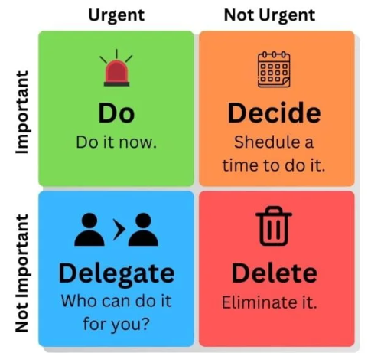
3. Understand, prioritise and schedule your key tasks
List your major tasks: describe scope, deliverables, timing, responsibilities etc.
Balance start and due dates for all your projects
Order monthly, weekly and daily priorities focus on the Do categories first
Manage your sense of being overwhelmed: break large tasks into sub tasks to help plan your daily or weekly loads
Practice saying No
Eisenhower Decision Matrix
Clearly signal to others your broad priorities and how you will allocate your time
If you need others’ help
  Match the right people to the task (their skills, experience and availability)
  Let them know why you’re asking/assigning it (done well it can enhance their role clarity, sense of purpose and mastery opportunities)
Notes:
Eisenhower Matrix, was popularized by business writers like Stephen Covey
This can be useful because, in requiring you to prioritise tasks by urgency and importance and figure out what you can delegate (or even not do at all) so that you can instead focus on the things that truly deserve your time and effort. High-performing people often struggle because they try to do too much. “In order to do some great things you will have to NOT do some nice to have done things.”

Slide 38

4. Practice time blocking
Alertness fluctuates with circadian rhythm and individual chronotypes (e.g., morning larks vs. night owls). Generally, there is a natural dip in alertness during the afternoon.
Schedule urgent, important and difficult tasks to when you are most likely to be alert
Time block/auto schedule each day/week times to
  Concentrate on highly complex or unfamiliar important tasks (make these email and meeting free)
  Complete boring but necessary tasks
This Photo by Unknown Author is licensed under CC BY-NC-ND
Notes:
Alertness fluctuates throughout the day due to our internal body clock, known as the circadian rhythm. Generally, most people feel most alert in the morning and evening, with a natural dip in alertness during the afternoon.

Slide 39
5. Aim for quality not speed
‘High-performing people often struggle because they try to do too much and say yes when they should be saying no or not just yet.’
Call out unreasonable timeframes and expectations
Do not promise to deliver in unrealistic timeframes or where there is inadequate information and resources
Signal to ELs, staff and colleagues your intention to strive for quality not speed
Notes:
High-performing people often struggle because they try to do too much. “In order to do some great things you will have to NOT do some nice to have done things.”

Slide 40
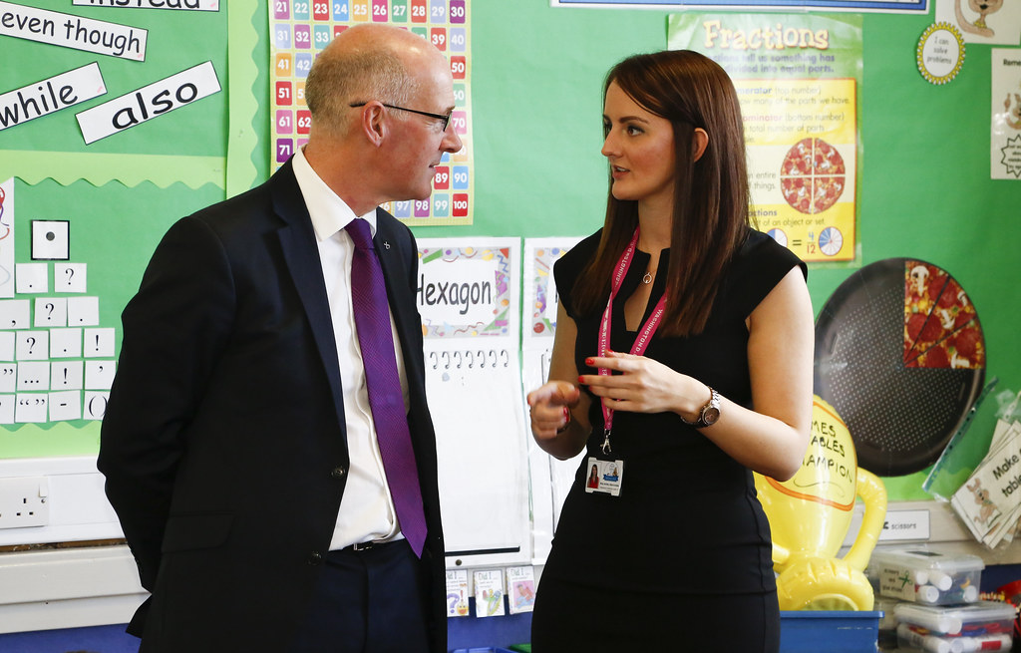
6. Limit your meetings and ensure these are well run
Decline unnecessary meetings (unless you have the time or they are fun)
Design high quality meetings
  Clear objectives: What do you or others want to achieve
  Structured agenda: With topics, allocated time, responsible person and required materials
  Right people attend
  Provide information needed for discussions (ideally ahead of time)
  Follow the agenda
  Start and end on time
  Allow positive respectful discussions
  Achieve the desired outcomes.
This Photo by Unknown Author is licensed under CC BY-NC
Notes:
Many executives report meetings can sometimes burn time and be a source of frustration. Important part of your role but opt out of the ones where you don’t need to be there

Slide 41
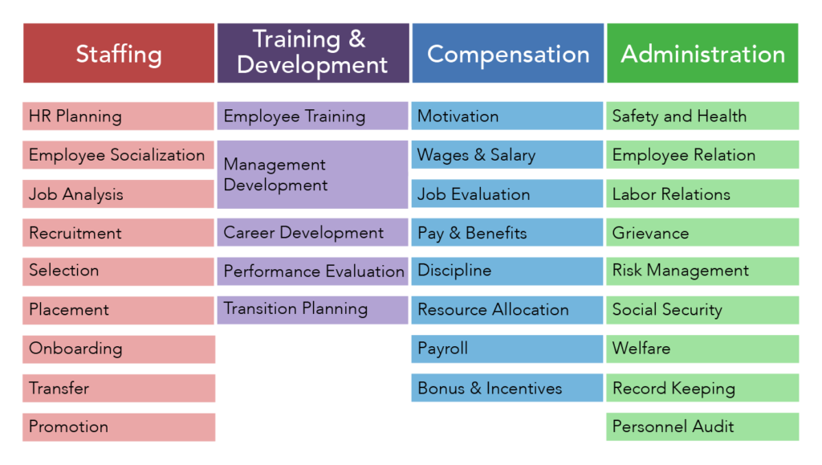
7. Optimise your task variety and rest breaks
Task variety enhances concentration and delays fatigue
Try to ensure reasonable task variety across your day and week – to reduce your cognitive loads alternate complex with process or boring tasks
If you find you alertness dipping
  Change to a task you enjoy
  Increase your office light levels
  Take a postural break (sit/stand/move)
  Consider software that prompts you to take a short break
Don’t skip scheduled breaks
Take micro breaks
Take your leave
This Photo by Unknown Author is licensed under CC BY

Slide 42

8. Optimise your physical comfort and safety
Ensure your work and home office suits you and your body
  Lighting and temperature
  Seating, desk height
  Computer and peripherals design
  Telephone headset
Appropriate personal security especially when working alone or after hours (doors locked) and getting to and from your car (outside lighting, security cameras, personal alarms etc.)
This Photo by Unknown Author is licensed under CC BY-SA-NC

Slide 43
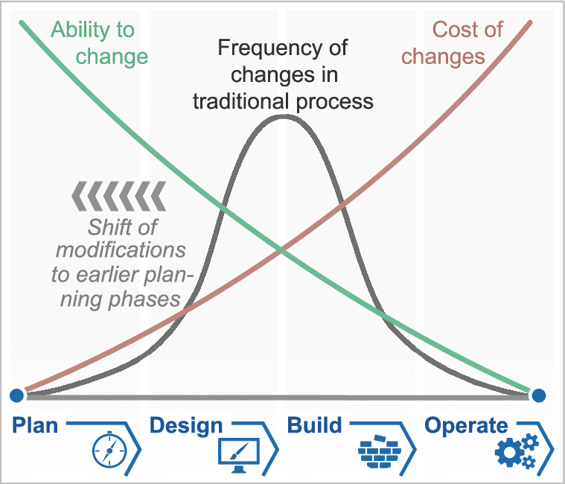
9. Insist on realistic project planning
Reduces everyone's workloads, is fairer and likely to avoid expensive late-stage changes
Ensure those helping to design and deliver projects are appropriately consulted and involved (from plan, design, build, operate to evaluation)
Insist on realistic project delivery timeframes (allow for likely delays, your own and others’ other work commitment, staff leave, training and turnover etc. )
Use project planning software to help visualize key tasks and track everyone’s progress (e.g., Microsoft planner, Asana, Gant Charts, Projectworks etc.)
Notes:
Likely to be involved in a range of projects from new schools, refurbishments, IT program, curriculum roll outs, etc.)
Reduces everyone's workloads, are fairer and likely to avoid late-stage expensive changes
Use software to help visualize tasks and track progress (e.g. Gant Charts, Microsoft, Asana etc.)
Ensure anyone helping to design the project or program is appropriately involved from design right through to construction, operation and evaluation

Slide 44

10. Seek greater practical and emotional support
Within your schools create collaborative problem solving and co-design leadership teams to help you with complex problems
Seek external support from trusted sources (peers, Communities of Practice, your union, EAP)
Demand appropriate practical support from your PCBU and EL
  Adequate resourcing (budgets, people and equipment)
  Appropriate ongoing ITSI
  Mentoring especially for new principals
  Crisis de-escalation support for you and your staff

Slide 45
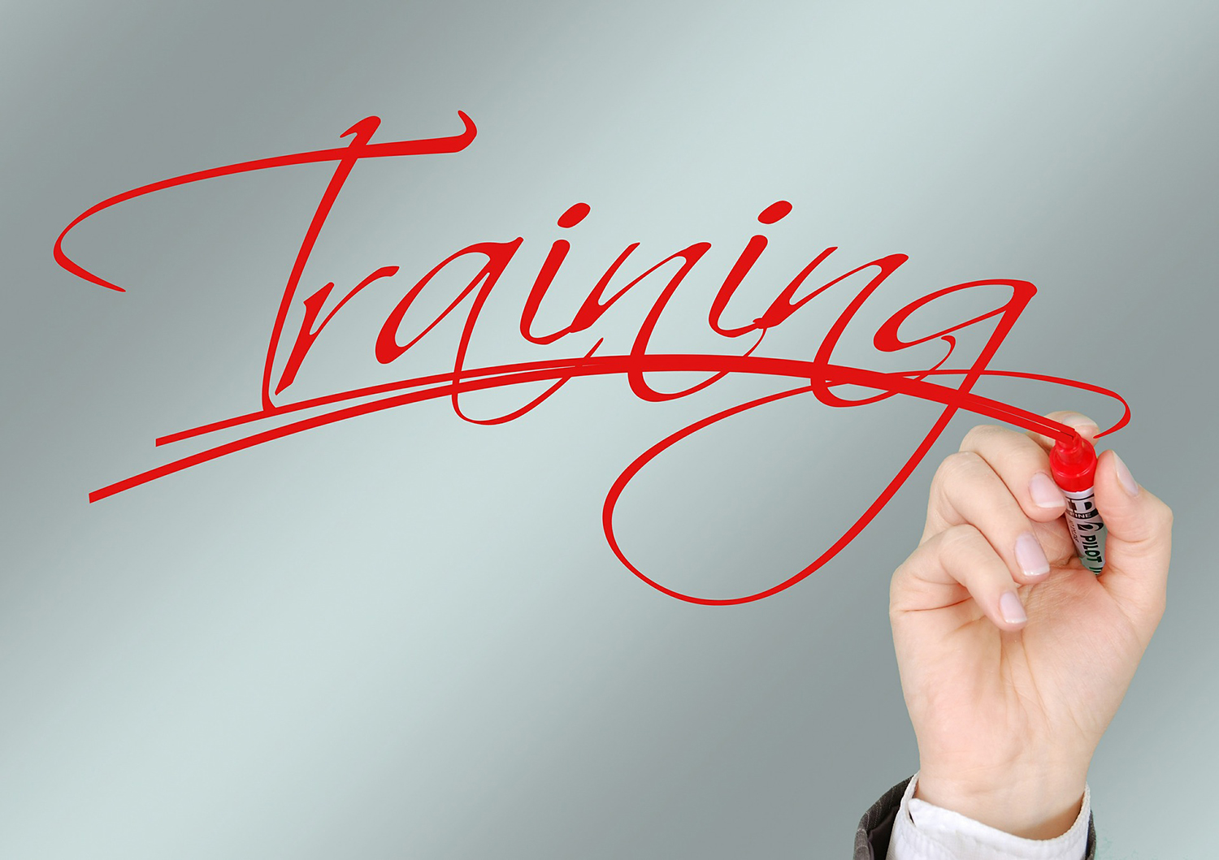
11. Demand high quality information, training, supervision and instruction
Your supervisor is legally a representative of your PCBU. They should be regularly discussing with you work situations, risks, management approaches and where required escalating matters to your PCBU.
ITSI should suit your learning preferences, occur when needed, be delivered by a competent trusted person. Topics might include:
  Budgets and financial planning
  Workforce planning
  Project management
  New or complex IT and IMS
  Strategic board management and
  Using trauma informed and strength-based approaches to assist staff, students and their families
Communicate clearly with your EL about the style and frequency of supervision your need
Notes:
Demand ITSI in the style that suits your learning, when you needed it, delivered by a competent trusted person
Demand appropriate ITSI (it is a legal obligation owed to you) especially for new or complex tasks like budgets and financial planning, dealing with boards and supporting staff using trauma informed and strength-based approaches
Communicate clearly with your REX so you get the ‘Goldilocks level and style of support’
Join a peer support network

Slide 46

12. Address student community poor behaviour risks
Apply systems level thinking and use community violence prevention forums to understand what is happening, triggers, perpetrators and targets to help address modifiable causes of poor behaviours
Effective CCC with support agencies and services like NDIS etc.)
  Facilitate families access to internal and external specialist support services
  Improve coordination ‘of school’ services
Positive Behavior for Learning (PBL) Framework
Community co-design of positive behaviour programs
Appropriate staff workloads so they have capacity to triage and respond
Improve site and equipment safety (safe decompression spaces, reduce access to throwing risks )
Security support (help when and where its needed by competent persons)
Adequate ITS&I
Clear and implemented behavioural policies and procedures
  Inform school community
  Place violence is not tolerated signs in appropriate locations in the school
  Enforce policies - right to refuse, student suspension and criminal consequences
Notes:
Understanding what is occurring, when/why (triggers) and who are the perpetrators and the targets
Multidimensional approaches required
Understanding what is occurring and why (triggers) and who are the perpetrators and targets
Community involvement in the school safety initiatives, including organising community violence prevention forums to understand triggers.
Adequate appropriate workloads to triaging and respond
Appropriate site and equipment design
Security - help when and where its needed
Adequate ITS&I
Enforced realistic policies - right to refuse and suspend students and implemented consequences
Promoting positive behavior,
Providing support services
Positive Behavior for Learning (PBL) frameworks to create a more positive, safe and supportive learning cultures and behaviors

Slide 47

13. Manage staff conflict and poor behaviour risks
Apply systems level thinking to understand and help address the modifiable causes of poor behaviours
Systematically address sources (see the CoP) such as excessive workload, lack of role clarity, poor support etc.
Increase practical and emotional support for staff
  Advocate for budgets for an ‘Ex on deck’ as a circuit breakers and provide immediate help for the teacher and you when dealing with distressed/disruptive students
Provide ITSI
Implement workplace behaviour policies
Safe reporting avenues and fair and proportional incident investigations and responses
Encourage staff to access support services
This Photo by Unknown Author is licensed under CC BY
Notes:
Persson, R., Leo, U., Arvidsson, I. et al. School principals’ proposals for preventive actions to impro https://archpublichealth.biomedcentral.com/articles/10.1186/s13690-024-01481-4#citeasve mental health. Arch Public Health 83, 19 (2025). https://doi.org/10.1186/s13690-024-01481-4

Slide 48

14. Practice self care and exercise your right to disconnect
13. Practice self care
Notes:
Persson, R., Leo, U., Arvidsson, I. et al. School principals’ proposals for preventive actions to impro https://archpublichealth.biomedcentral.com/articles/10.1186/s13690-024-01481-4#citeasve mental health. Arch Public Health 83, 19 (2025). https://doi.org/10.1186/s13690-024-01481-4

Slide 49

Notes:
Are their suggestions of policy that doesn’t work too long what mechanism what can you influence do to help fix it to make a change

Slide 50
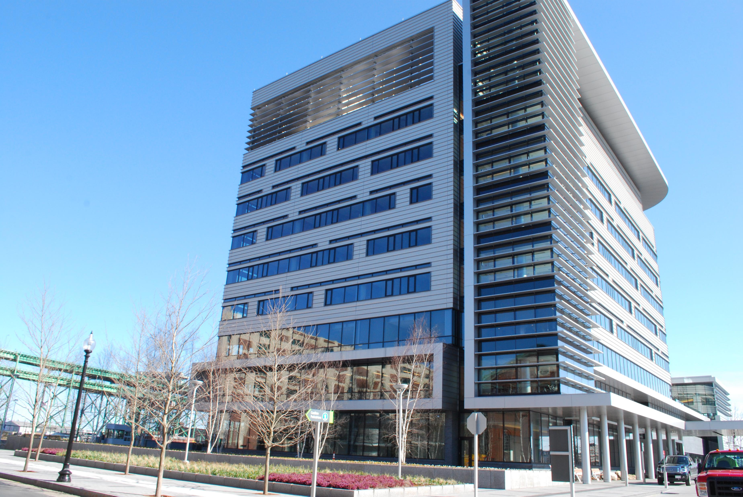
Suggestions:
ACT wide or school cluster projects
  Targeted principal support training – budgets, financial accountabilities, workload management, HR and IR
  Shared IT and accountancy resources for school clusters
  Physical safety through improved school design
  Investment in Communities of Practice and Principals’ Collaboration Networks
  OV prevention and response program funding that match marketplace delivery and evaluations costs
    Rebalance focus from tertiary level intervention (providing medical care and rehabilitation to injured workers) towards greater investment in primary prevention (designing out risk) and secondary interventions (immediate post event responses)

Slide 51
Suggestions:
Enhanced ED leadership and governance
WHS part of senior executive performance metrics
Realistic school staff student ratios and staff budgets
Adequate budgets for educational equipment and supplies
Improved IT and IMS design (user friendly) and rollout coordination
Simplified streamlined rules for documentation and reporting incident notifications
Notes:
Helps establish clear boundaries between work and personal time, promoting work-life balance and opportunities to recover from a demanding job.
In Australia, ACT workers have a right to disconnect from work-related contact outside of their working hours.
You can and should reasonably refuse to monitor, read, or respond to work-related messages or calls outside core working hours including from the directorate or third parties like parents or students, or employees in other directorates/agencies (unless the refusal is deemed unreasonable).
You should understand and implement the right to disconnect, including communicating with staff and the school community about expectations and boundaries. And model it!

