Slide 1
Time poverty and devolved accountability
Understanding complexity in school leaders’ work
Associate Professor Anna Hogan
School of Education, Queensland University of Technology

Slide 3
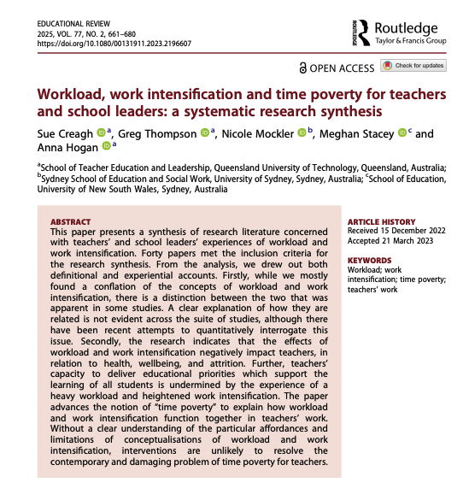
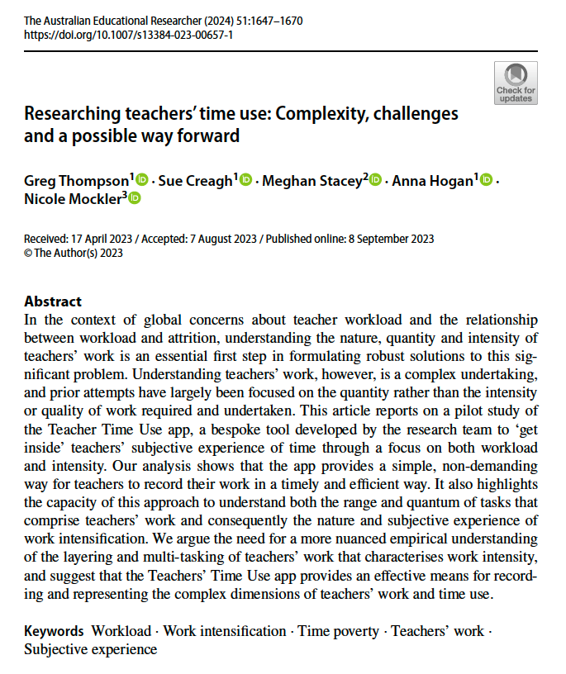


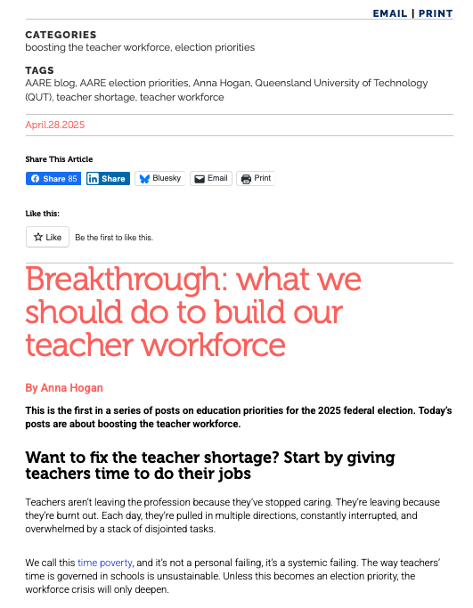
ARC Linkage project with the QTU:
Time Use, Time Poverty and Teachers’ Work

Slide 4
Understanding time poverty
Time poverty is the relationship between:
The amount of work a teacher does, or perceives that they have to do; and
The intensity of that work, which may be expressed as the number, complexity or stakes associated with decisions that need to be made over a given period.

Slide 5

The Time Use App
Before school | 30 minutes of time use | After school
I slept well. I am looking forward to the school day. I feel prepared for the school day. Overall, I feel positive today. | Possible activities include: Leadership activities Face-to-face teaching activities Preparation and teaching admin Student wellbeing responsibilities outside lesson time Other activities outside the classroom Each activity is broken down into a selection of more specific tasks. Number of decisions made Enough time to complete the work | My workload felt manageable Reason? I felt rushed today Reason? Estimate remaining hours of work to do tonight. How typical was the day? Any other comments.

Slide 6
Time slot coverage
 | Monday | Tuesday | Wednesday | Thursday | Friday | TOTAL
8:00 | 65 | 61 | 51 | 40 | 31 | 248
8:30 | 65 | 51 | 68 | 62 | 39 | 285
9:00 | 65 | 52 | 63 | 45 | 44 | 269
9:30 | 70 | 46 | 50 | 52 | 33 | 251
10:00 | 51 | 50 | 56 | 52 | 44 | 253
10:30 | 84 | 45 | 67 | 43 | 46 | 285
11:00 | 60 | 62 | 64 | 62 | 41 | 289
11:30 | 67 | 71 | 59 | 52 | 32 | 281
12:00 | 71 | 69 | 66 | 62 | 39 | 307
12:30 | 76 | 52 | 68 | 46 | 40 | 282
1:00 | 73 | 54 | 63 | 54 | 45 | 289
1:30 | 79 | 53 | 60 | 52 | 40 | 284
2:00 | 83 | 56 | 60 | 47 | 32 | 278
2:30 | 52 | 56 | 54 | 51 | 30 | 243
3:00 | 76 | 41 | 65 | 53 | 36 | 271
3:30 | 66 | 55 | 53 | 58 | 39 | 271
TOTAL | 1,103 | 874 | 967 | 831 | 611 | 4,386

Slide 7
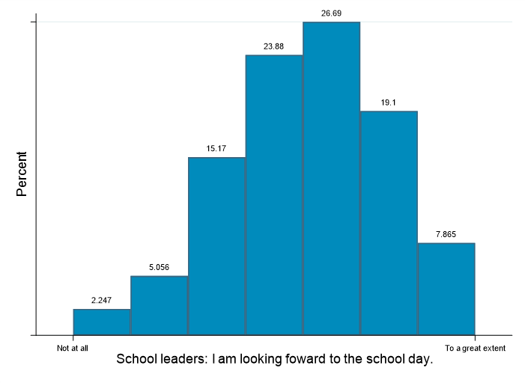
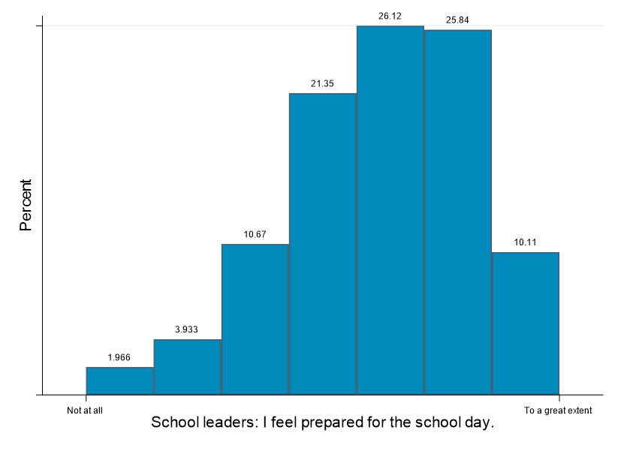
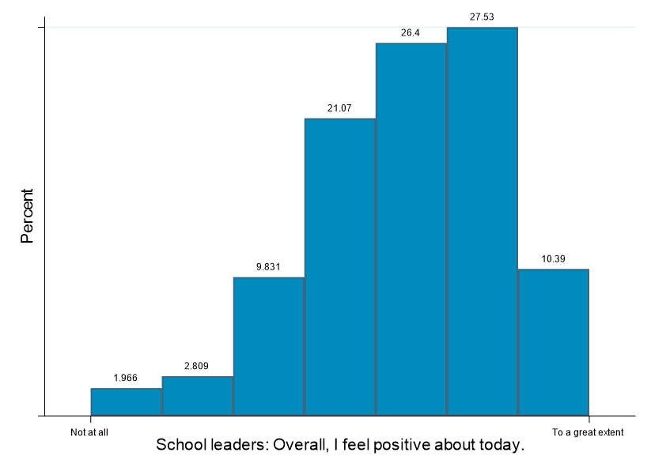
School leaders start the day positively

Slide 8
30-minutes of time use
 | Mean (minutes) | Standard Deviation (minutes) | Median (minutes) | No. of observations (timeslots)
Total time | 72 71 (teachers) 82 (leaders) | 60 60 64 | 55 54 64.5 | 4,273* 3,923 350
School leadership responsibilities | 50 | 31 | 38 | 703
Face-to-face teaching | 48 | 23 | 45 | 2,362
Preparation and admin tasks | 32 | 22 | 30 | 1,835
Student wellbeing responsibilities | 19 | 17 | 13 | 1,513
Activities outside the classroom | 47 | 41 | 31 | 1,473

Slide 9
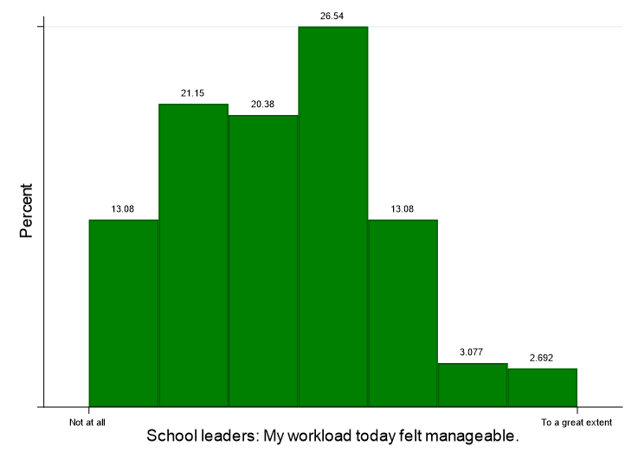
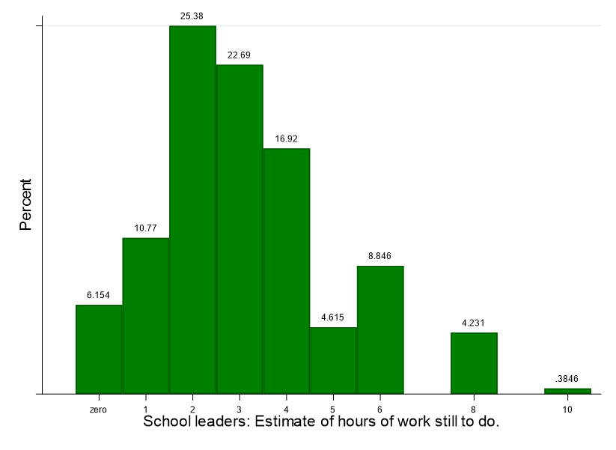
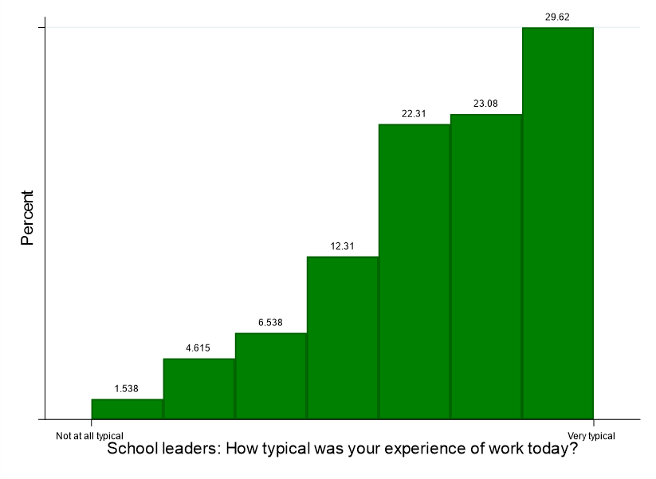
School leaders’ end the (school) day under continuing time-pressure

Slide 10
Triaging of time
“I do my deputy work at school from 6-8am and from 4-7pm. I’ll do more at home too. But during the day I’m just reactive to what’s happening in front of me…”
“Everyday is putting out spot fires, with either staff or with students.”
“My needs as a school leader sometimes seem to be at the bottom of a large list of conflicting priorities. On many occasions my responsibilities do not get done due to being responsive to student needs and parent requests.”
“If I think about a lawyer or a doctor or an accountant, they’ve got a task. They put time aside and sit down and do that task. I can't stay on a task when critical stuff is happening. Whether it's a high-level behaviour incident, obviously the suicide ideations or people coming onto grounds, those things you can't hide in an office and stay away.”
“All day was spent on keeping complex students in the right place, working with their families and ensuring safety of the students and others. I am feeling very overwhelmed at losing hours of work time to crisis management. It now needs to all be recorded in OneSchool.”

Slide 11
Cascading effects: HR and staffing
“So teachers message me if they are sick and from 5.30 in the morning, I will start making phone calls with our relief teacher list. But we've had multiple days where we can’t get relief teachers. So we take an inclusion teacher off, or I take my HPE teacher off. So then I've got to manage making up non-contact for people who miss non-contact, plus their non-contact. And I've got to shuffle staff around constantly.”
“This morning, I was here at 6 and I had someone at my door at 6.10 saying, Can I talk to you? And then that person left, and then 15 minutes later there was another one. So I've had 3 staff this morning, and they've all got stuff going on. And I love the fact that they will come and talk about it, but it's also, OK, now I've got to keep those tabs going and try and solve it through the day.”
“There's 65 people who want part-time next year. So every single person who wants 0.8. you can't give them an actual day off, right? … because of the way the timetable works [and] I lose 42 minutes on every single 0.8 person… Well, we can’t get that back from anyone else. So, we can't run particular subjects… we can't give time to people who are running our debating programmes or sports teams... We've got a lot of people who just give for the love of it.
“So just yesterday, I suspended a student because he's called the teacher an F and C and thrown a chair. Um, so managing that, you know, and then I've got another student who's done a similar thing to the same teacher. Well, that student didn't get suspended because of other circumstances. So it's that feedback to staff and that lack of consistency that usually brings people unstuck. You know, I'm not being supported by admin cos such and such did this and swore at me, if you swore you should be suspended. But it doesn't work that way, you know.”

Slide 12
Cascading effects: Infrastructure
“My maintenance budget here for a year is about $14,000. Right? We’ve just had a fig tree cut down beside a building where there are toilets because I would spend $14 to $20,000 just getting roots out of that toilet system each year. Um, then you're looking at, uh, over allocations of money with maintenance and improvement work, and then you have to decide either stay with Q build or you go open to market… I stay with Q build because I would rather pay the 15% markup than ask [BM] to go and tender everything and evaluate, you know, everything from licencing to regulation.”
“There's often a part of the the funding that's dedicated to furniture, but that can easily get sucked up by finding a bit of asbestos that's got to be removed and then no furniture. So, everything in this office that you're sitting on is donated. We've got a connection with a company that does refits in public service buildings. And they can't can't sell off furniture, but they can give it away. Otherwise, it goes into landfill. So, we've just had four truck loads of furniture; everything from cupboards to filing cabinets, tables, chairs, computer risers, computer desks, You name it, um, without that, we would still be sitting on furniture that was given to this school in the 1950s.”
“Our P&C has probably put in the last five years. It would have to be at least a quarter of a million dollars in this place. Um, and that's been everything from ipads to buildings to gardens to murals to tuck shop upgrades. Um, furniture you name it. Um, we really shouldn't have to ask P&Cs to be coughing up for some of those things.”

Slide 13
Cascading effects: Student welfare
“Our teachers are pretty good at dealing with the smaller stuff, so it's usually the biggest stuff that we get, and it depends on the incident, because if there's something happened, um, and sometimes it's just talking to the student or removing them and giving them some time out so they'll be in my my room with Lego calming down or whatever, while I need to try and get my work done, but they're talking to me, or I've still got to be responsible to them. So then you're multitasking, and I suppose, the quality of work you get done then diminishes, Um, but for some of them, it's then it's It's a bigger it can be hours cos you need to talk through a student. You might need to do a whole investigation. If there was a group. I did one the other day, and by the time I'd spoken to the parents, put it up on OneSchool and everything, it was a good 2.5 hours.”
“Our tier 3, tier 4 students, take up an inordinate amount of time and you have the same conversations over and over again trying to get students support from their families and that can not always hit the mark. So what that invariably needs is just this constant touching base and organising meetings and things like that. Our admin, our student services team, which is like our heads of year, guidance teams, and especially our HOSs and her staff, uh, every single day their workload is crazy.”
“Uh, the other thing in our school, I've probably got 16 kids, which I would call high to extreme risk of suicide. The first three terms would have meant at least weekly we were dealing with, um, high suicide risk, calling ambulance, overdose on site or coming to presenting to school after overdosing, uh, and then managing the impacts that has on their cohort. Uh, our staff. You know, these young people then need safety plans. Risk plan, you know, risk assessments. So the the paperwork that sits in behind that, um, impacts some of those young people coming onto grounds. Some of them have been resuspended. You've gotta have all the plans in place, whether that's a discipline improvement plan, uh, individual behaviour support plan, uh, trying to get meetings with families, meetings with regional staff. Um, so you know each individual one of them can be hours of work in that space.”
“I've had a few female staff who have identified that they, um, felt very uncomfortable and very threatened by what the boys think is just joking around.”

Slide 14
The toll
I've got great skills, but in terms of of my willingness and my ability to to go through that vicarious trauma and have that coming home with me every day to my own family, that's a really big ask… By the time you develop the skills, the attitudes, the beliefs, the values, um, you're you're well over 50 and you're tired. You've been doing things that you shouldn't have been asked to do for for many years. The principals’ well-being survey they're doing every year. That is a really interesting piece of of data. And, uh, for as long I've been doing it, I'm told to see a psychologist and stop drinking and exercise more and like no, no, no, no, no. The Prosecco is keeping me going.
There's never really a day or a night where this place doesn't feature in the front of my head. It's pretty hard to switch off and think about your kids' parties or Christmas or or anything like that. I constantly think about how that family with the six kids whose mum tried to hurt herself and what's going to happen to those kids and and how do I support that dad, uh, in moving through that? It's not a It's not a job where you ever switch off.
I describe a lot of us as economic captives because our skills don't translate to other industries or they're not respected by other industries. You get to a certain age and you've got, you know, a family and kids and cars and mortgages. You can't just walk away and take a 50 grand a year job. I can't live on that. My family will suffer, so you stay and then you get to a point where you you're close enough to retirement, and you just gotta hang in there.

Slide 15




Time poverty and its consequences
What emerges from this project reinforces the relationship between the experience of time and job satisfaction.
Time poverty is not just how much work school leaders have to do, it is their experience of that time – the ‘heavy hours’ – and the consequential effects of:
This is not an individual failure; it is a systemic failure.
The pressure they feel
Things that ‘block’ their satisfaction
The multi-tasking needed (how many balls can you juggle?)
The cascading effects that particular events, processes and expectations have.

Slide 16
What kind of system produces these conditions?

Slide 17



The promise of autonomy
Decentralisation of Control
Autonomy is presented as a deeply desirable policy condition, especially for school leaders navigating increasingly complex educational landscapes.
Empowerment of Leaders
Positioned as a mechanism to empower leaders to make decisions reflecting the unique needs, values, and aspirations of their school communities.
Professional Ideals
This promise taps into principals' own professional ideals—that they are not merely implementers of bureaucratic directives, but trusted experts capable of making contextually intelligent decisions.

Slide 18
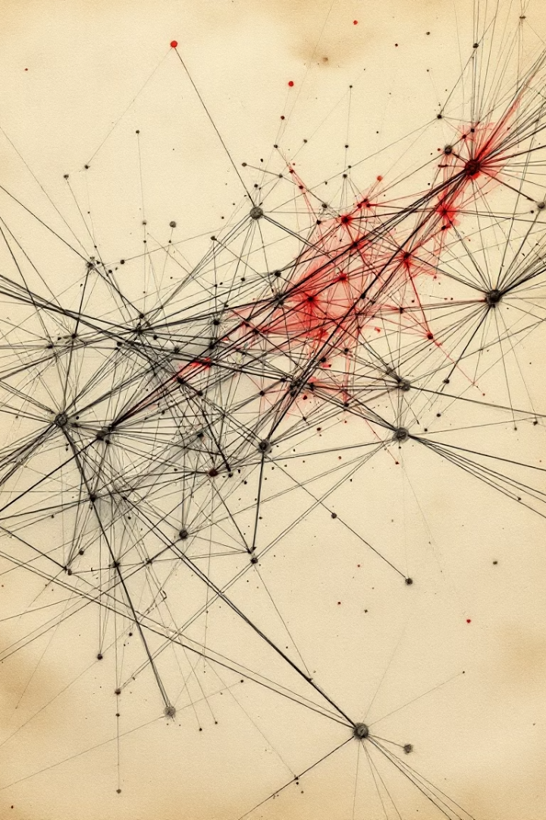
The reality of devolved accountability
Responsibilisation
Autonomy functions as a mechanism of responsibilisation — a means of delegating risk and burden downward from the system to the individual school level.
Policy
Rather than being free to imagine and pursue novel solutions tailored to their communities, principals are more often working reactively within the boundaries set by marketised policy architectures, aiming to avoid failure, reputational harm, or resource loss.
Governance
What is sold to principals as professional autonomy is, in reality, a mechanism of governance — a strategic policy technology that reframes structural underfunding and inequality as local leadership challenges.
Survival
Autonomy here becomes a narrow calculus of survival, not a platform for creative leadership.

Slide 19

Towards intelligent professionalism
Intelligent professionalism argues for a different kind of professional autonomy, one that is:
Collective, not individualised
Strategic, not reactive
Guided by evidence, not market logics
Grounded in mutual accountability between schools and the state.
It recognises that public education is a state-mediated profession. But it insists that teachers and school leaders—and their unions—should be at the centre of shaping the policies, structures, and practices that govern schooling.
It’s a professionally-led system, not a managerially-driven one.

Slide 20
References
Creagh, S., Thompson, G., Mockler, N., Stacey, M., & Hogan, A. (2025). Workload, work intensification and time poverty for teachers and school leaders: A systematic research synthesis. Educational Review, 77(2), 661-680.
Cuskelly, L., Hogan, A., & Thompson, G. (2024). Commercial triage in public schooling: COVID-19, autonomy and ‘within system’inequality. Journal of Educational Administration and History, 56(4), 448-464.
Hogan, A., Gerrard, J., & Di Gregorio, E. (2023). Philanthropy, marketing disadvantage and the enterprising public school. The Australian Educational Researcher, 50(3), 763-780.
Hogan, A., & Thompson, G. (2023). Running the canteen for profit: Funding, parents and philanthropy in Queensland state schools. Critical Studies in Education, 64(5), 464-478.
Le Feuvre, L., Hogan, A., Thompson, G., & Mockler, N. (2023). Marketing Australian public schools: The double bind of the public school principal. Asia Pacific Journal of Education, 43(2), 599-612.
Stacey, M., Creagh, S., Mockler, N., Hogan, A., & Thompson, G. (2024). The time poor teacher: Understanding the intensity of decision-making. In Teaching and Time Poverty (pp. 179-196). Routledge.
Thompson, G., Hogan, A., & Stacey, M. (2023). The heavy hours. Australian Educator, 118, 21-23.
Thompson, G., Hogan, A., Mockler, N., Stacey, M., & Creagh, S. (2025). Time Use, Time Poverty and Teachers' Work: Preliminary Report on Phase 3.
Thompson, G., & Hogan, A. (Eds.). (2024). Teaching and time poverty: Understanding workload and work intensification in Schools. Taylor & Francis.
Thompson, G., & Hogan, A. (2024). Beyond workload. In Teaching and Time Poverty (pp. 216-220). Routledge.
Thompson, G., Creagh, S., Stacey, M., Hogan, A., & Mockler, N. (2024). Researching teachers’ time use: Complexity, challenges and a possible way forward. The Australian Educational Researcher, 51(4), 1647-1670.

